Slide 1
SARCASM DETECTION
SUMMER PROJECT
Presented by:
SNEH BHARDWAJ (A002)
SANCHI JHAMB (A005)
AASHITA SHARMA (A017)
ISHA SONI (A022)

Slide 2
INTRODUCTION

Slide 3

What is Sarcasm?
Sarcasm
is “a sharp, bitter, or cutting expression or remark”. The use of irony to mock or convey contempt.
Sarcasm implies sentiment, detection of sarcasm in a text is crucial to predicting the correct sentiment of the text.

Slide 4
WORK FLOW

Slide 5




Sarcasm Detection
Selecting Dataset
Data Pre-Processing
Model Building
Model Deployment
(Using classifiers and rule based methods)

Slide 6

Data Source
This News Headlines dataset for Sarcasm Detection is collected from two news website:
TheOnion
HuffPost
Dataset contained 26,709 headlines, of which 14,931 were Sarcastic and 11,778 were Not Sarcastic
https://www.kaggle.com/
rmisra/
news-headlines-dataset-
for-sarcasm-detection

Slide 7
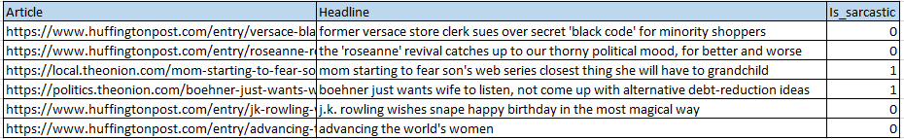
Data Snapshot

Slide 8



Attributes
article_link
Link to the original news article. Useful in collecting supplementary data
headline
The headline of the news article.
is_sarcastic
1 if the record is sarcastic otherwise 0

Slide 9
DATA PRE-PROCESSING

Slide 10




Feeding Dataset
Converting textual data to Python readable data structure
Matching Pattern
Feature Selection
Stemming
Bag of Words
A regular expression is a special sequence of characters that helps you match or find sets of strings.
Feature selection is for filtering irrelevant or redundant features from your dataset.
Stemming is the process of reducing inflected words to their word stem, base or root form—generally a written word form.
The bag-of-words model is used for classification where the (frequency of) occurrence of each word is used as a feature for training a classifier

Slide 11
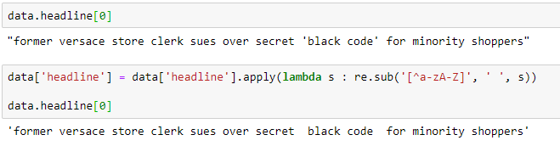
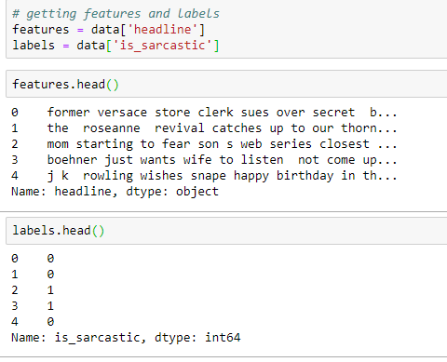
Matching
Pattern
Feature
Selection

Slide 12
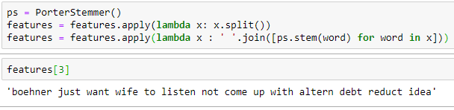
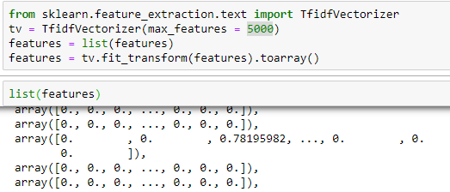
Stemming
Bag of Words &
Vectorization

Slide 13

Bag of Words: TF-IDF
It is a general process of turning a collection of text documents into numerical feature vectors.
This is an acronym that stands for “Term Frequency — Inverse Document” Frequency.
Term Frequency: This summarizes how often a given word appears within a document.
TF = (Number of times term T appears in the particular row) / (number of terms in that row)
Inverse Document Frequency: This down scales words that appear a lot across documents.
IDF = log(N/n), where, N is the total number of rows and n is the number of rows in which the word was present.

Slide 14
DATA PROCESSING

Slide 15

Initial Stage
We divide the dataset into:
Test Data – 5% of the original data
Train Data – 95% of the original data

Slide 16
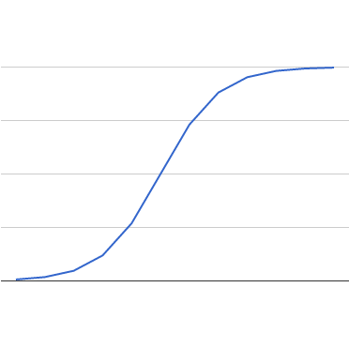
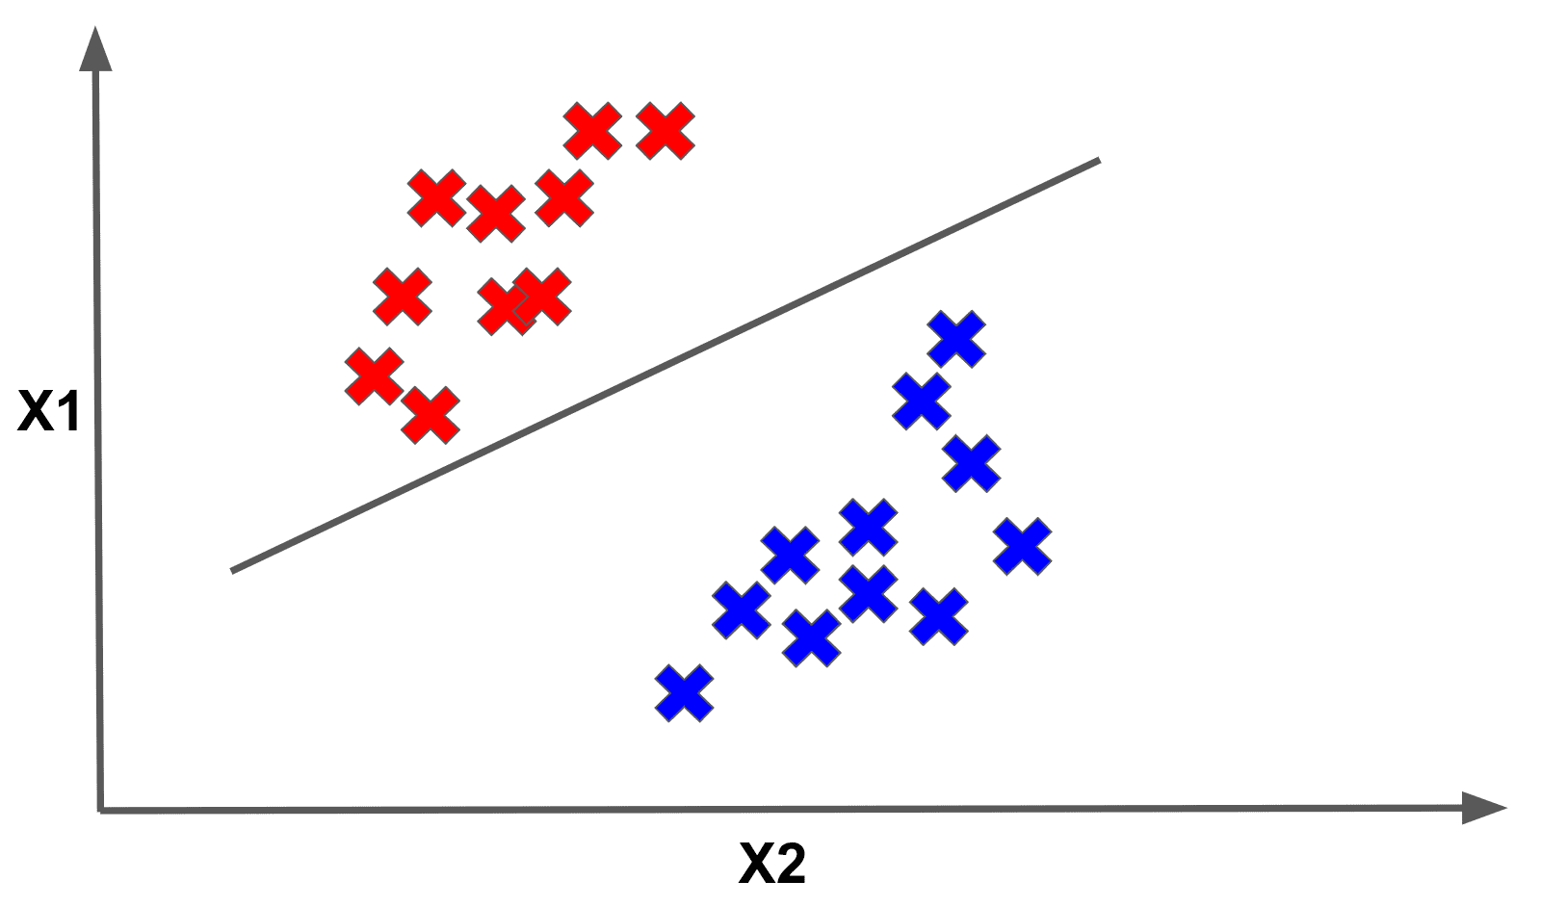

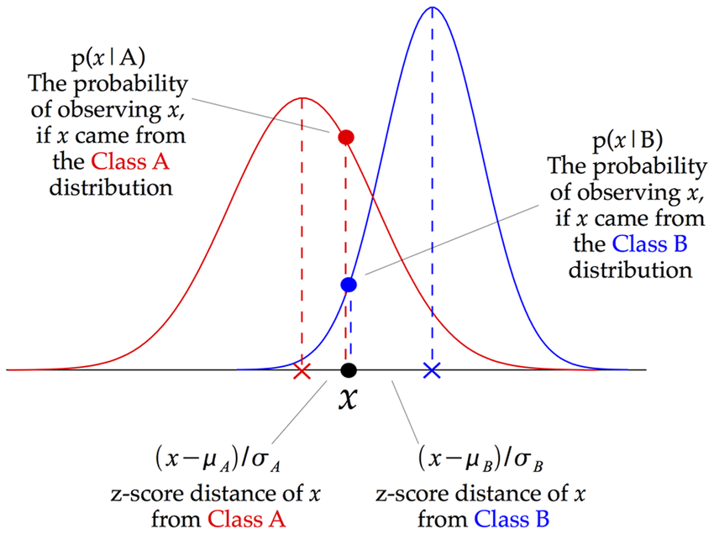
Model Building
Using Classifiers
LRC
LSVC
RFC
GNBC
Logistic Regression Classifier
Linear Support Vector Classifier
Random Forest Classifier
Gaussian Naïve Bayes Classifier

Slide 17
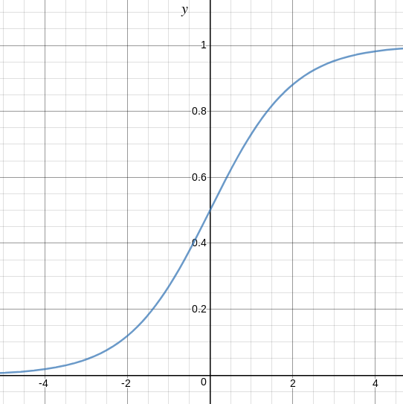
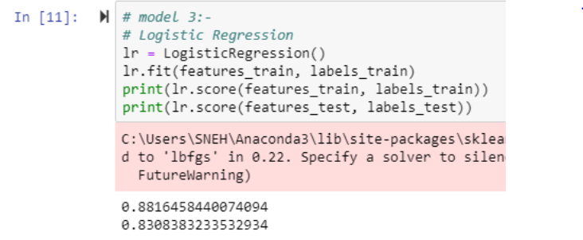
Logistic Regression Classifier
Supervised binary classification algorithm
Builds a regression model to predict the probability that a given data entry belongs to the category numbered as “0” or “1” , S-shaped curve
Models the data using the sigmoid/logit function.

Slide 18

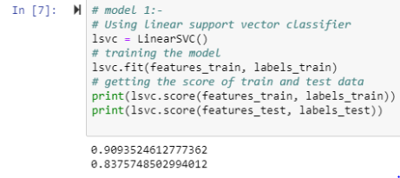
Linear Support Vector Classifier
SVM produces significant accuracy with less computation power.
Main objectives of SVM is to find an optimal hyperplane in an N-dimensional space that distinctly classifies the data points.

Slide 19
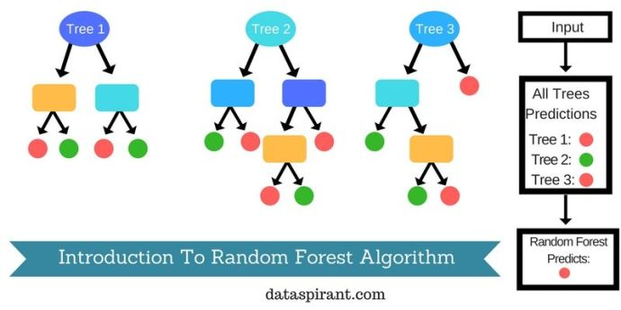
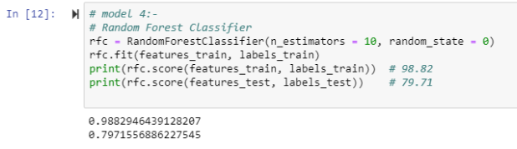
Random Forest Classifier
Ensemble Classification Algorithm
Random Forest Classifier Function

Slide 20
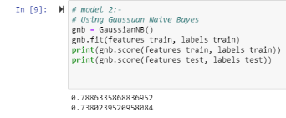
Gaussian Naïve Bayes Classifier
Class Probabilities
Conditional Probabilities
Mean, standard deviation, Gaussian PDF

Slide 21
Model Validation
Model Name | Testing Score
Linear Support Vector Classifier | 83.75
Gaussian Naïve-Bayes | 73.80
Logistic Regression | 83.08
Random Forest Classifier | 79.71

Slide 22
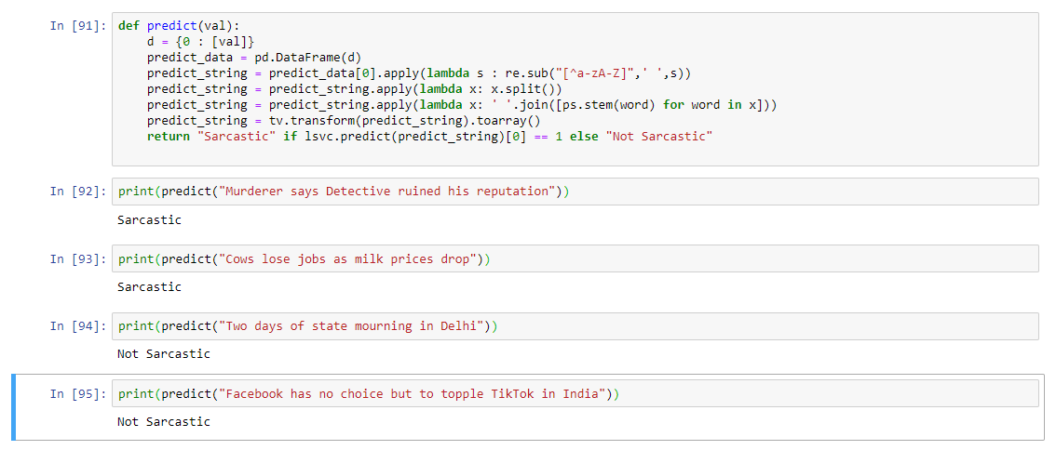
Model Deployment

Slide 23
Thank you!

